Slide 1

VV156 Mid RC Part II
Derivative and Optimization
Chengyang Shi

Slide 2
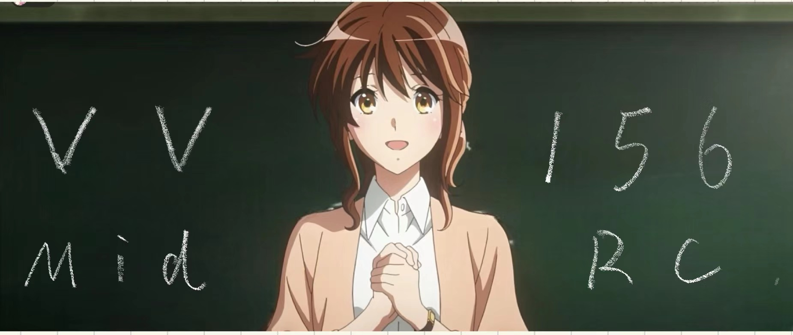

Slide 3
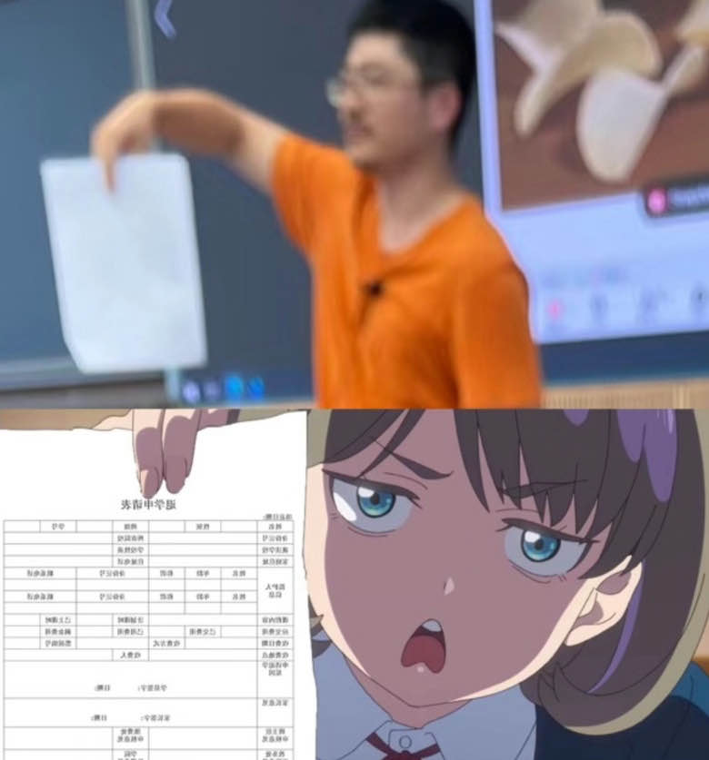
Contents
Definition of Derivatives
Differential Formulas
Chain Rule
Implicit Differentiation
Logarithmatic Differentiation
Inverse Function Differentiation
Optimization Problems
Mean Value Theorem
L’Hospital’s Rule

Slide 4
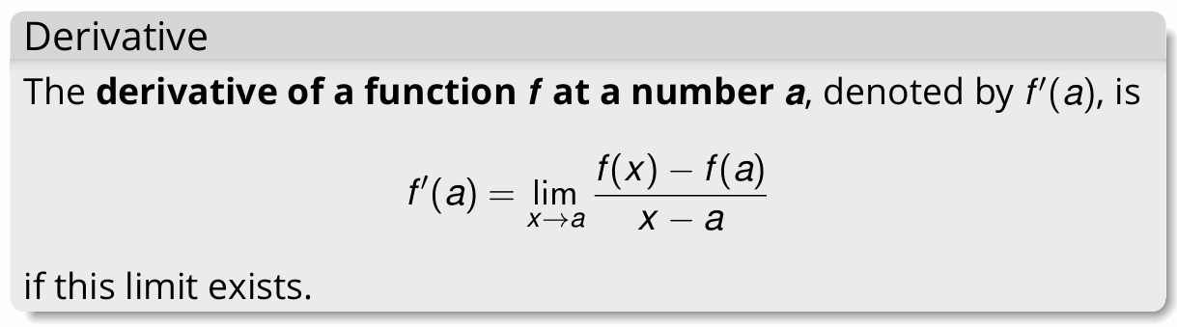

Definition of Derivatives
Geometry Interpretation: Tangent Line
The slope of the tangent line of a function is the corresponding derivative.
Physical Interpretation: Instantaneous rate of change
Definition:
Notations:

Slide 5
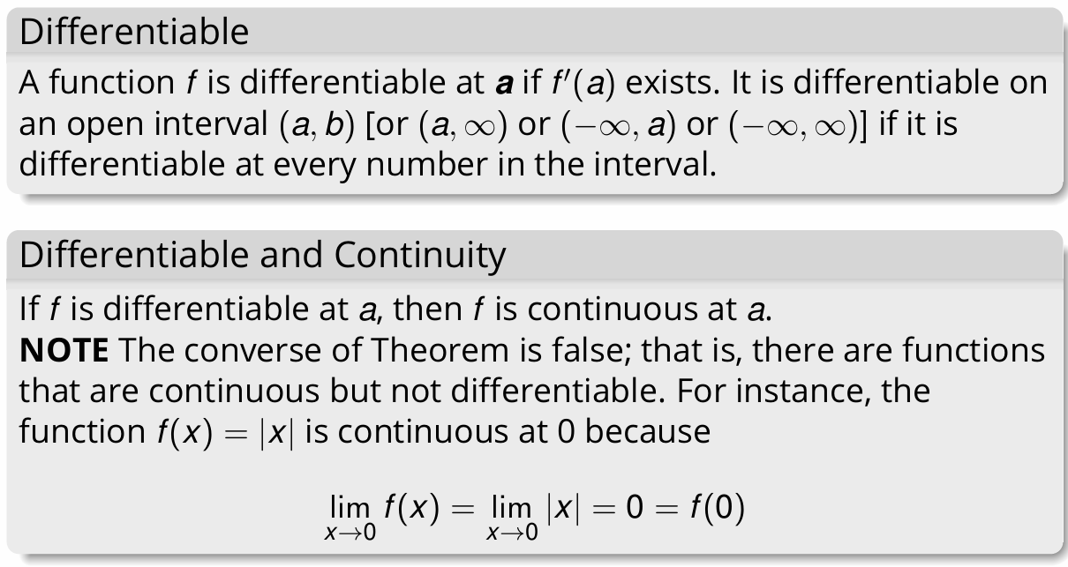
Differentiable

Slide 6
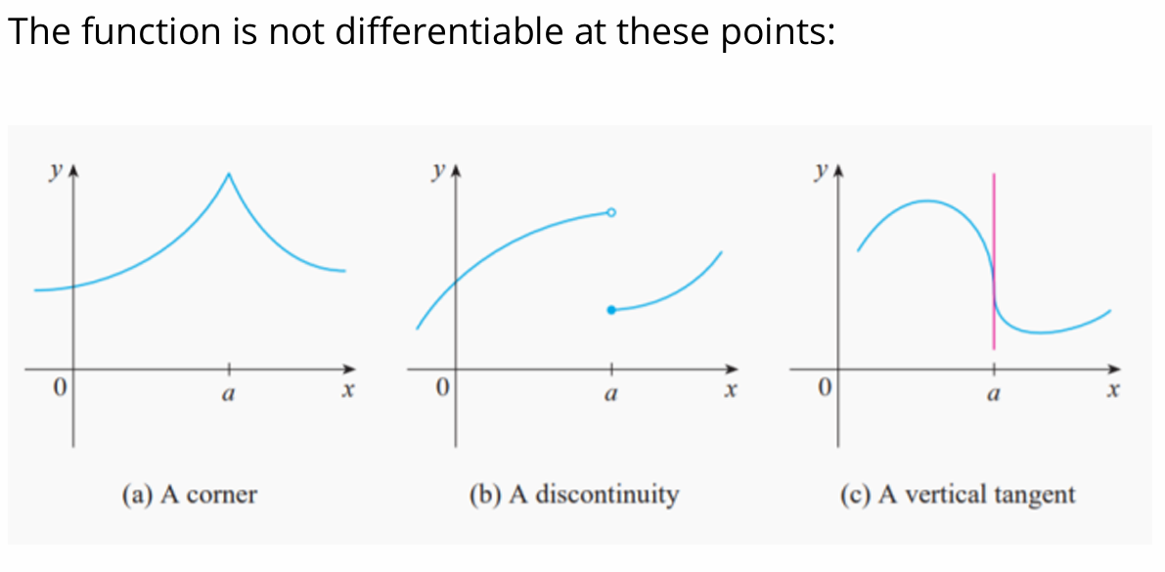
Differentiable

Slide 7
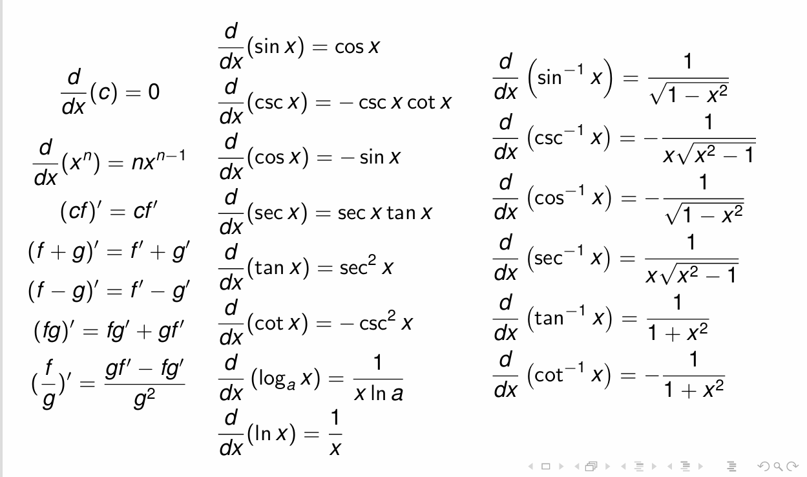
Differential Formulas

Slide 8
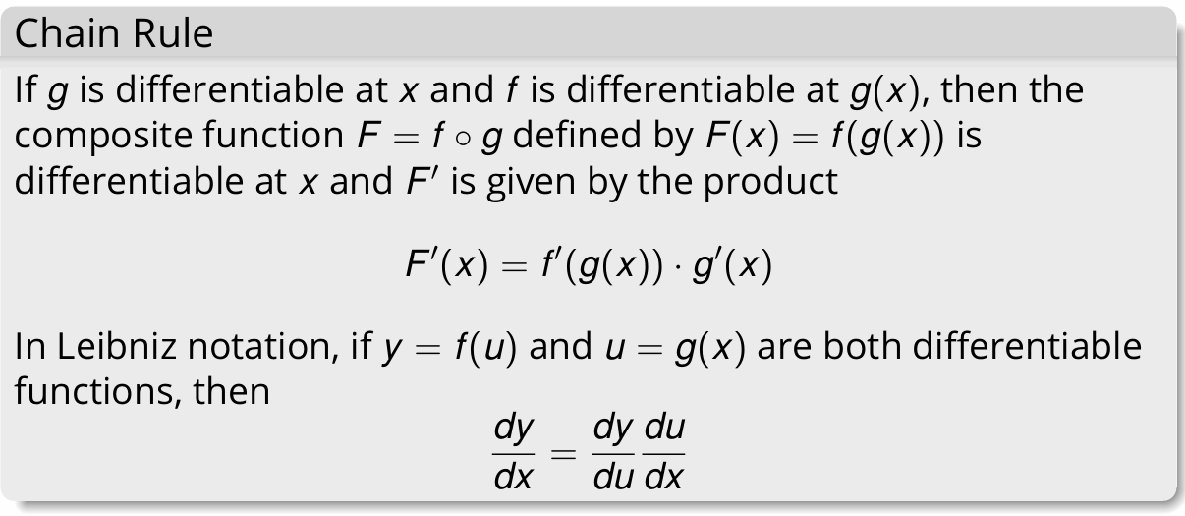
Chain Rule

Slide 9
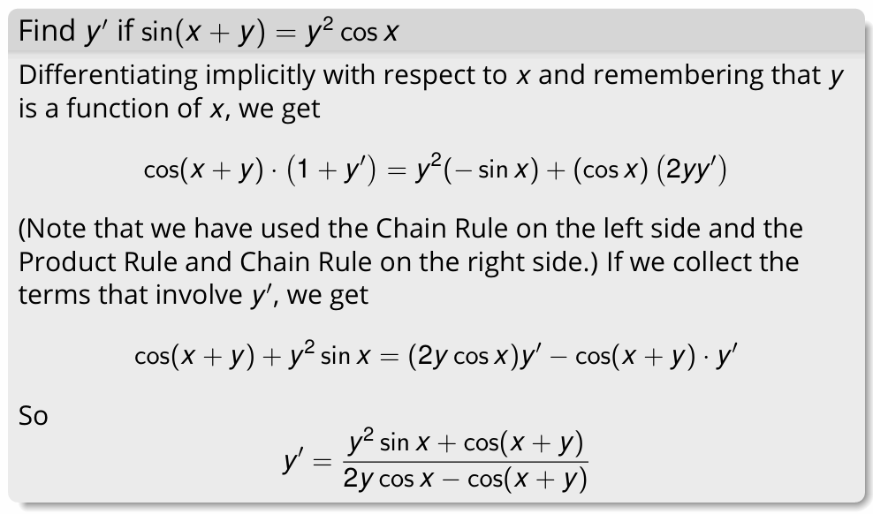
Implicit Differentiation

Slide 10


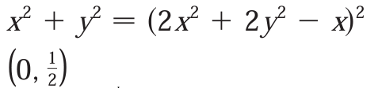

Slide 11
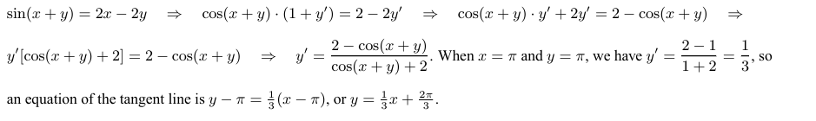
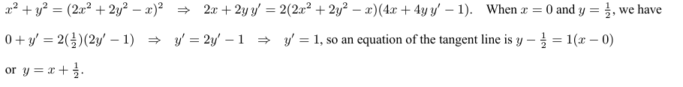
Solutions

Slide 12
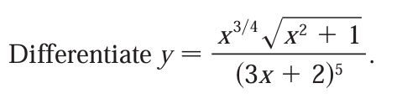


Logarithmatic Differentiation
Prof.Cai has mentioned the example in the lecture. If you have difficulty with this problem, do check your notes before the exam.

Slide 13
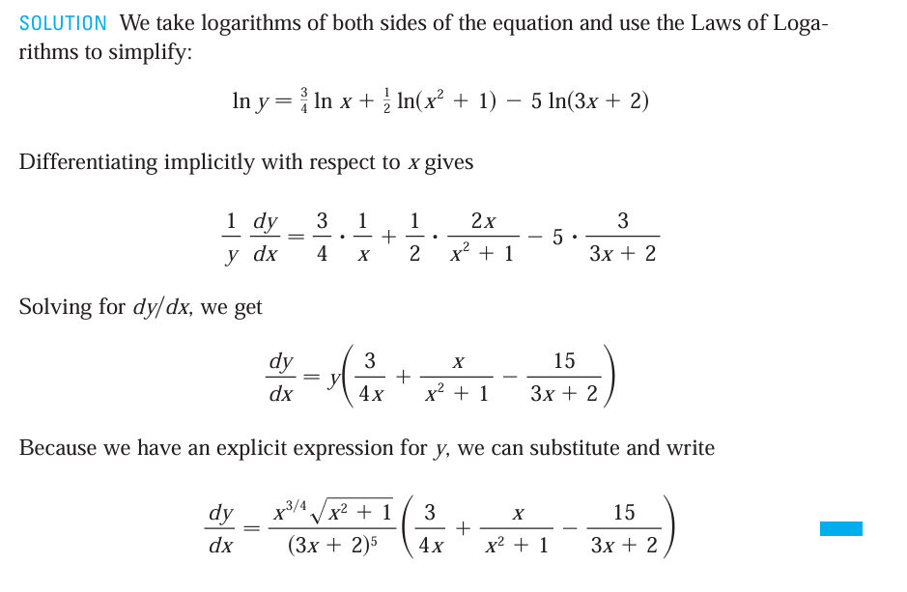
Solutions

Slide 14
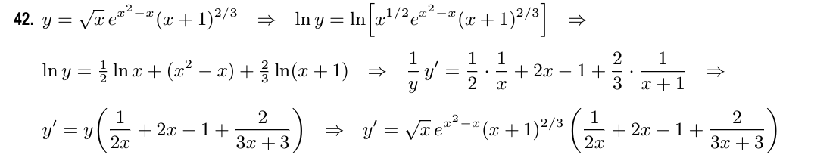
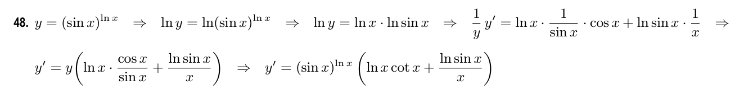
Solutions

Slide 15
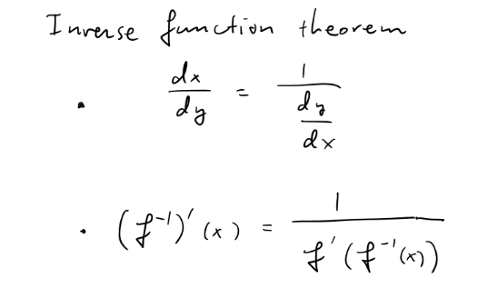
Implicit Differentiation

Slide 16

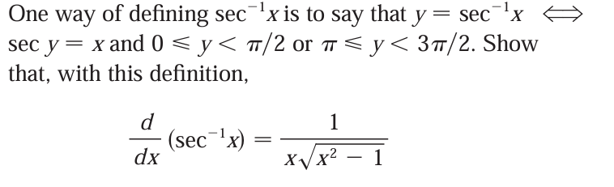
Implicit Differentiation

Slide 17
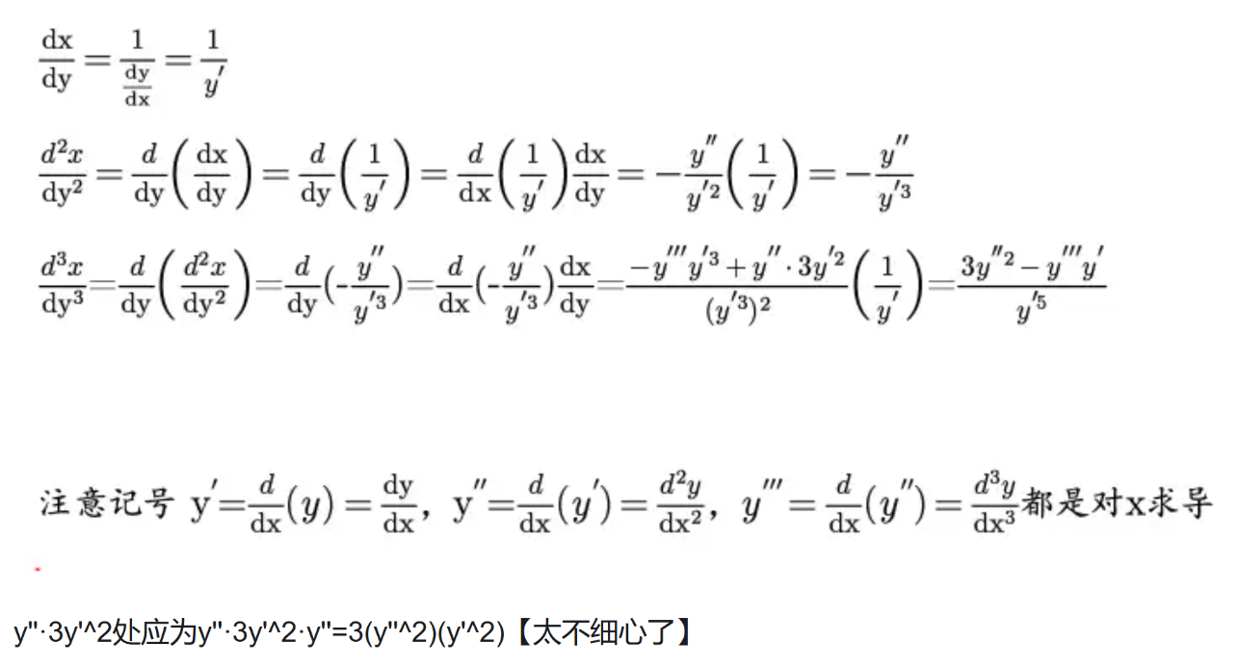
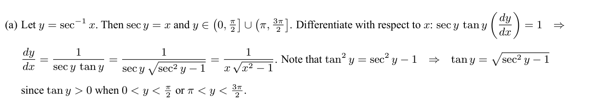
Solution

Slide 18
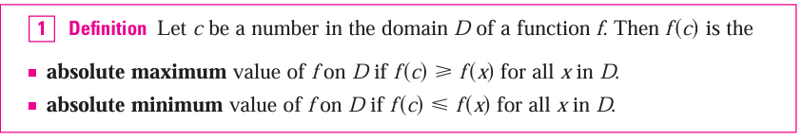
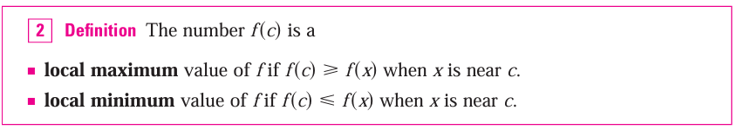
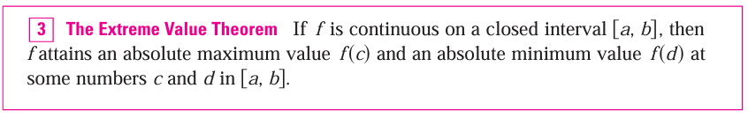
Optimization Problems

Slide 19
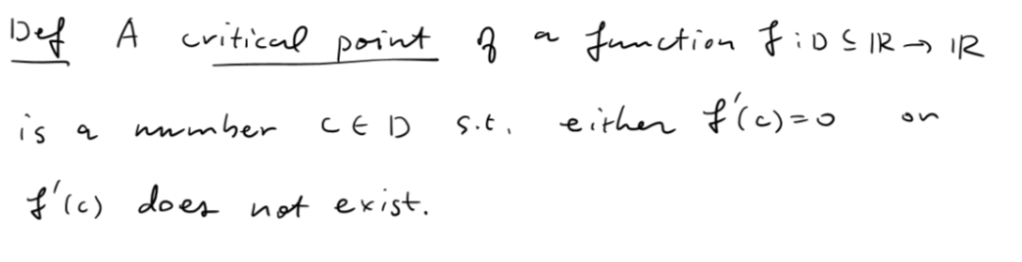
Optimization Problems

Slide 20
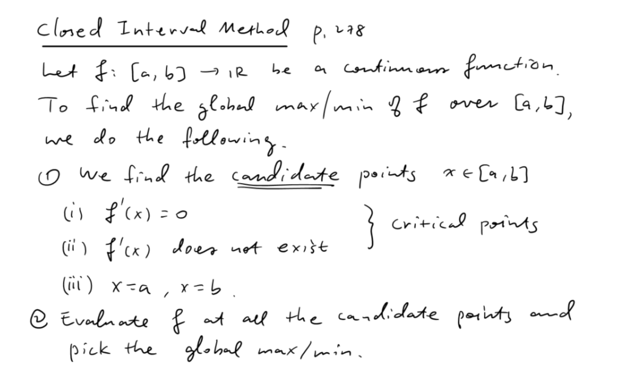
Optimization Problems

Slide 21




Optimization Problems

Slide 22
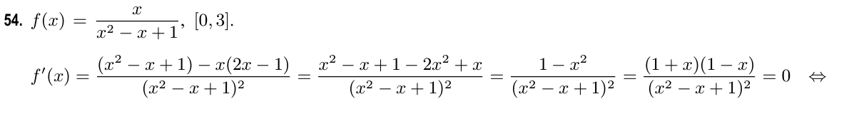
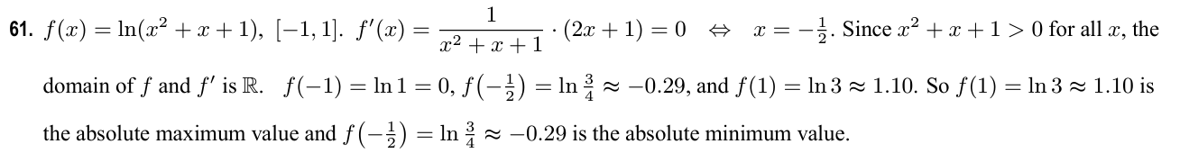
Solution

Slide 23
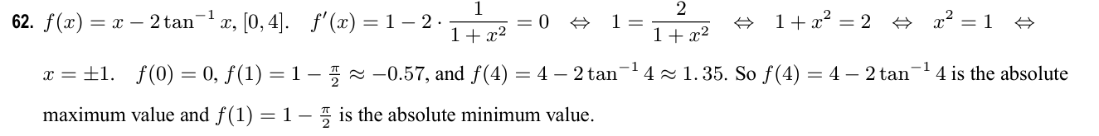
Solution

Slide 24
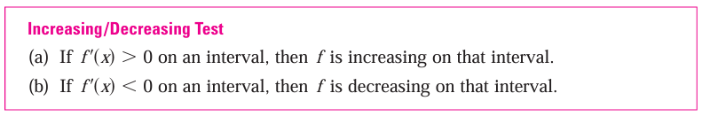
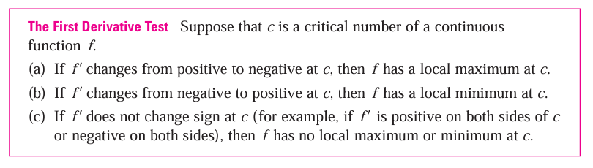

Optimization Problems

Slide 25
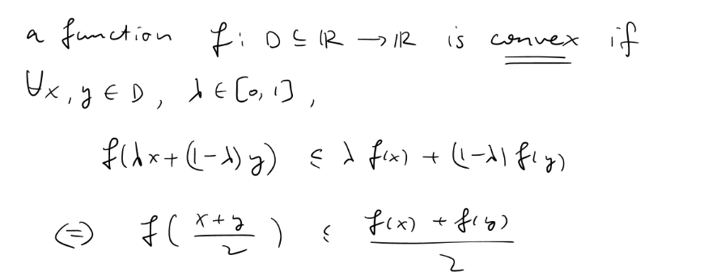
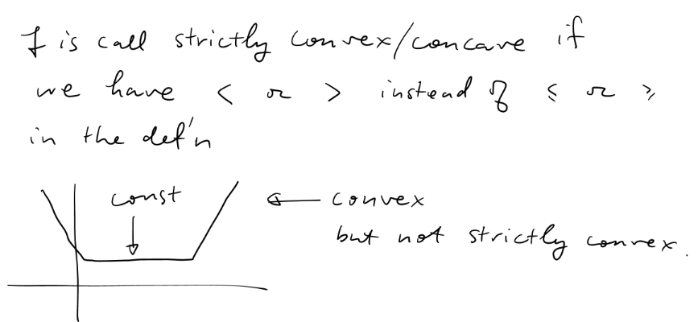
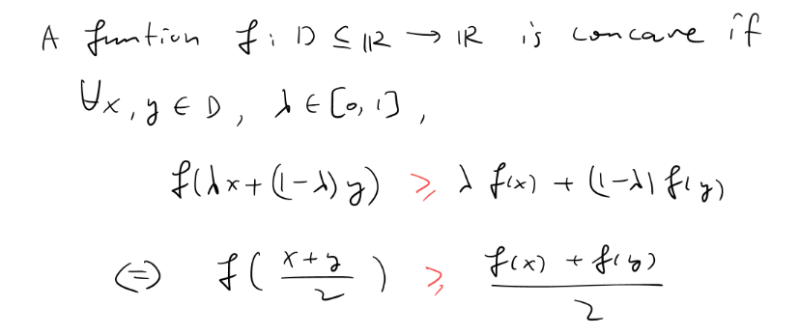
Optimization Problems

Slide 26
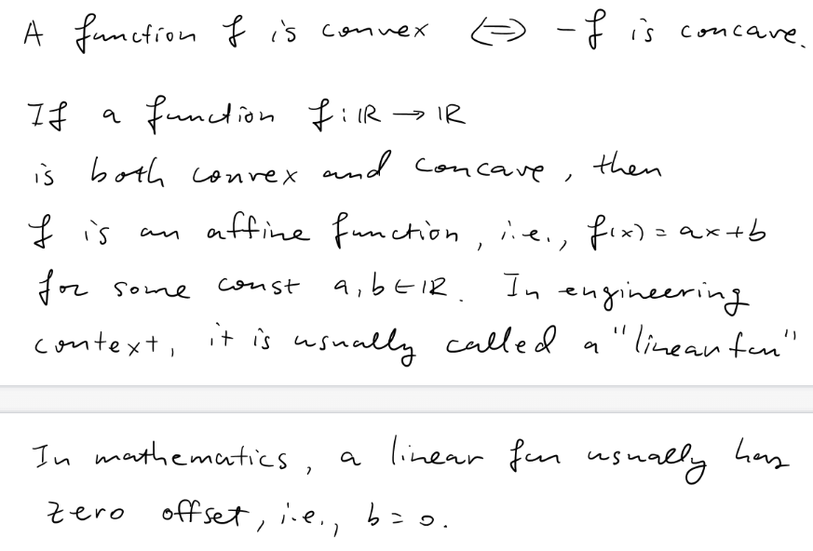
Optimization Problems

Slide 27
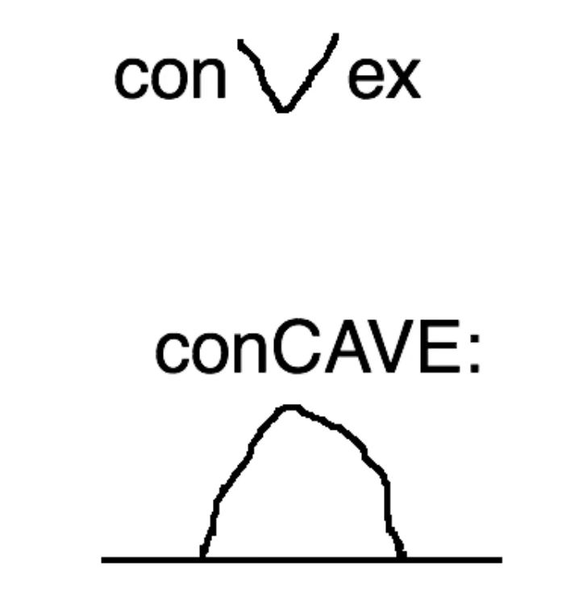

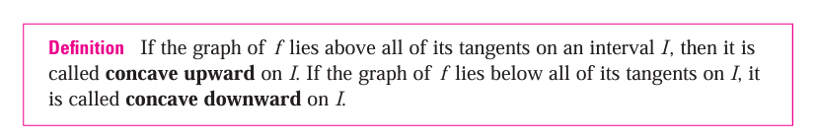
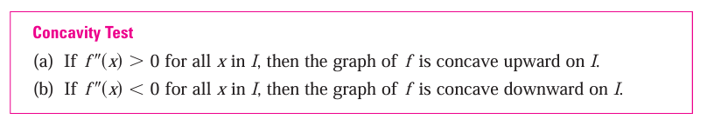
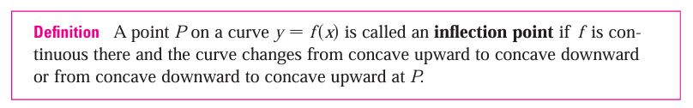
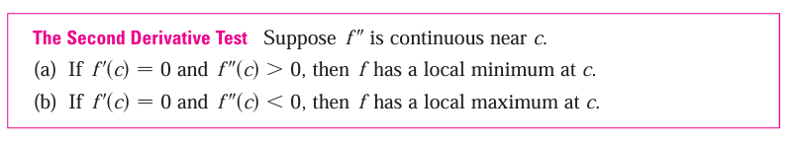
Optimization Problems
Note that, “concave upward” is
equal to “convex”, “concave
downward” is equal to “concave”.
And Prof.Cai will prefer the
notation of “convex” and “concave”

Slide 28
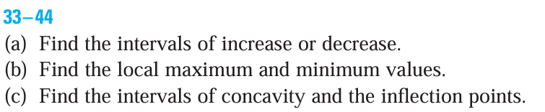


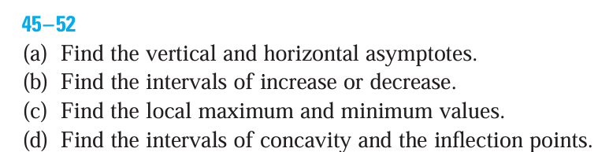


Optimization Problems

Slide 29
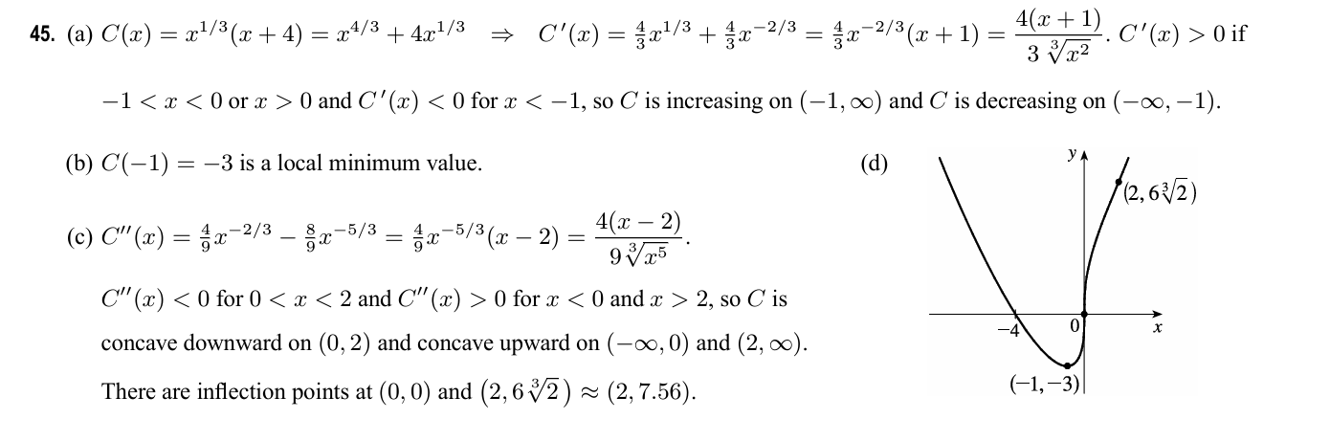
Solution

Slide 30
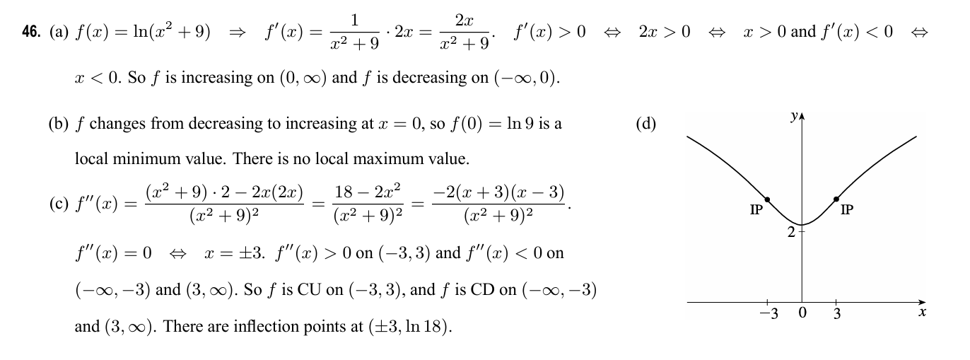
Solution

Slide 31
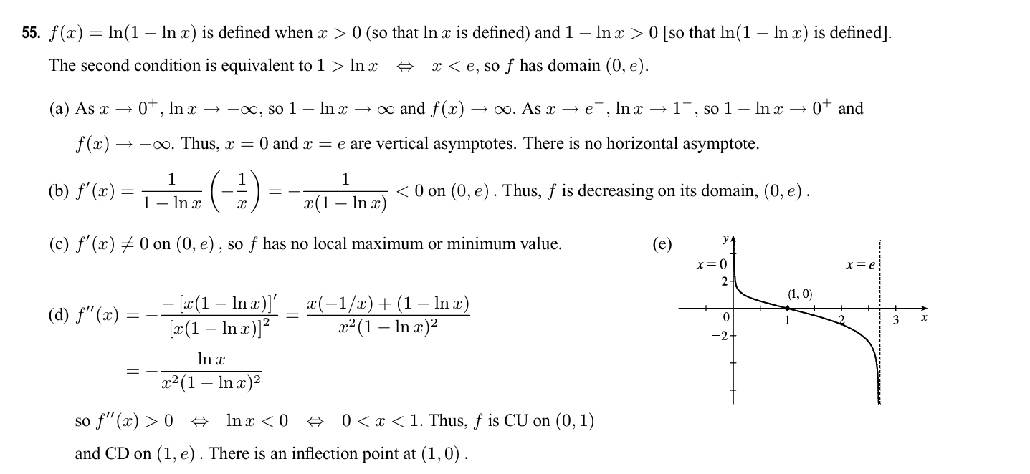
Solution

Slide 32
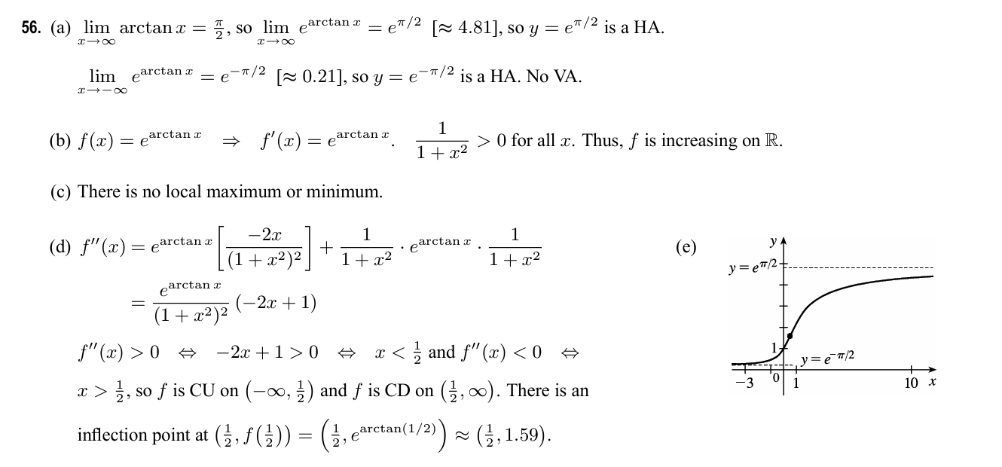
Solution

Slide 33
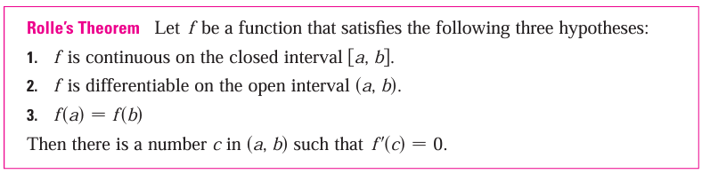
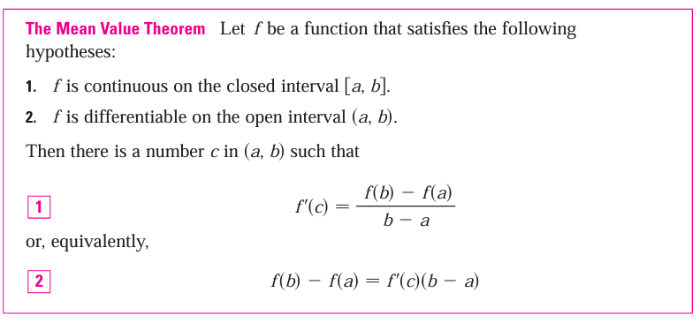
Mean Value Theorem

Slide 34
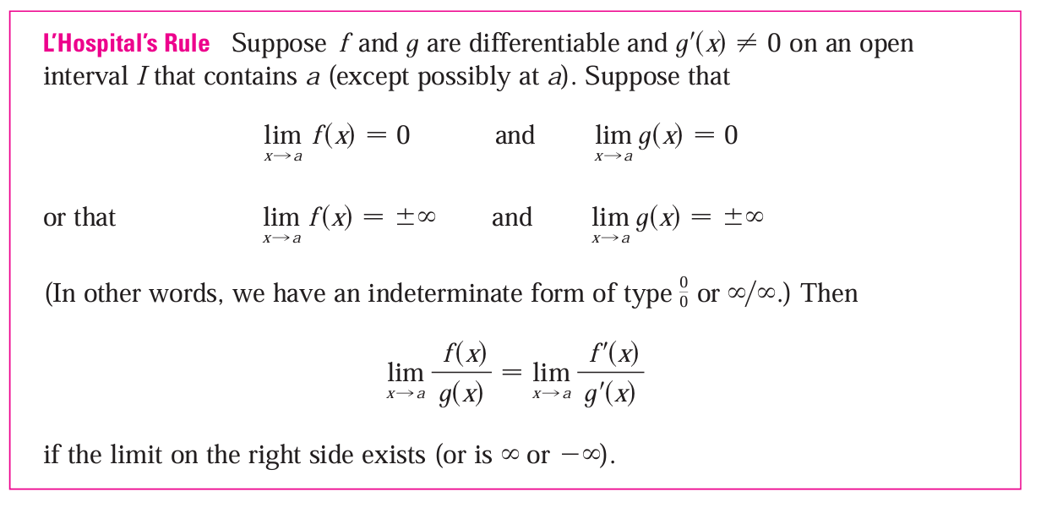
L’Hospital’s Rule

Slide 35
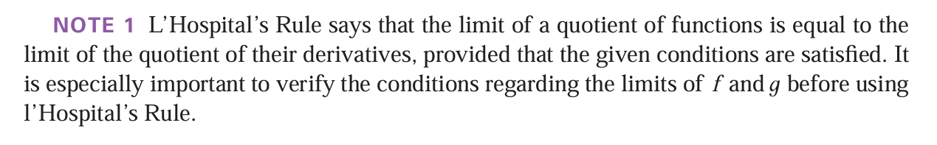
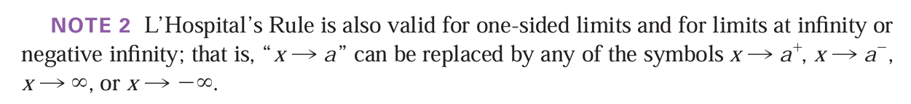
L’Hospital’s Rule

Slide 36
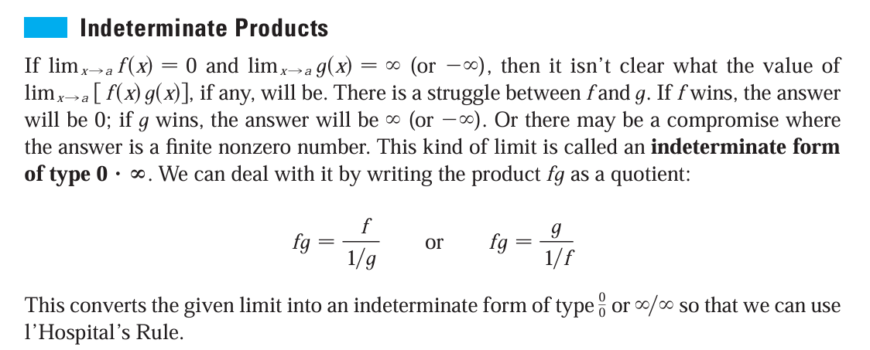
L’Hospital’s Rule

Slide 37

Example

Slide 38


L’Hospital’s Rule

Slide 39

L’Hospital’s Rule

Slide 40

L’Hospital’s Rule

Slide 41


L’Hospital’s Rule

Slide 42





L’Hospital’s Rule

Slide 43





L’Hospital’s Rule

Slide 44


Solution

Slide 45


Solution

Slide 46


Solution

Slide 47


Solution

Slide 48

Solution

Slide 49
Reference
VV156 23FA Mid RC Part 3, Mingrui Li
James Stewart Calculus Early Transcendentals 7th Edition
VV156 24FA Lecture Notes, Runze Cai

Slide 50

THANK YOU AND GOOD LUCK！

